Slide 1

Agenda
Good morning, everyone.
Thank you, John, and thank you all for your time.
Over the next thirty minutes, I will discuss how Geneformer’s in-silico perturbation capability was applied to the Virtual Cell Challenge.
The agenda for today’s discussion is organized into these four main sections. And all of these are connected to one another if you look
First, I will provide a brief overview of gene embeddings, how these embeddings are derived from Geneformer, and an introduction to in-silico perturbation, including how this process is implemented within Geneformer.
Next, I will explain how the Virtual Cell Challenge is connected to in-silico perturbation.
The third section focuses on how Geneformer’s in-silico perturbation capability was specifically applied to the Virtual Cell Challenge.
Finally, I will present the results obtained. To keep this section concise, I will focus on the two most effective approaches that were used.

Slide 2
Gene Embeddings
Geneformer is a BERT-based biomedical foundation model trained on approximately 316 million single-cell transcriptomic profiles.
To explain how gene embeddings are extracted from Geneformer, we start with the model input.
Each cell is provided to Geneformer in the form of a cell-by-gene expression matrix. When this input is passed through Geneformer’s tokenizer, the model identifies the top 4,096 highly variable genes, regardless of the total number of genes present in the cell.
These selected genes are then ranked based on their importance, with transcription factors typically appearing at the top of the ranking and housekeeping genes toward the bottom. This structured input representation is referred to as rank-value encoding.
The rank-value encoded representation is subsequently passed to Geneformer’s encoder, which produces gene-level embeddings.
Gene embeddings are dense vector representations that capture the functional and contextual properties of genes within a specific cellular state. In biomedical foundation models, these embeddings are learned from large-scale single-cell RNA-seq data using transformer architectures. Each gene embedding reflects co-expression patterns, regulatory relationships, and shared cellular contexts. As a result, distances and directions within the embedding space correspond to biological similarity.
In Geneformer, the gene embeddings within a cell are averaged to obtain a single cell embedding, which represents the overall cellular state.

Slide 3
Insilico Perturbation in Geneformer
What Perturbation is ?
Perturbation means a small change or disturbance to a system, affecting its regular motion, behavior, or quality
And About insilico Perturbation specifically computational simulation of biological interventions using a trained model instead of performing physical experiments.
There is an interesting property of these cell embeddings- mostly all the cells will cluster together and even if they don’t cluster geneformer provides the feature of supervised finetuning on classification task and separate them into different clusters
An important property of cell embeddings is that, in many cases, cells tend to cluster together in the embedding space. When such separation is not clearly observed, Geneformer provides the capability for supervised fine-tuning on classification tasks, which helps distinguish and separate different cellular states into distinct clusters.
The UMAP visualization shown here is based on an actual experiment conducted by three of us—myself, Dr. Sana Munquad, and Vani Padmakumar—using PC9 cell lines. Vani and Dr. Sana curated and labeled the datasets to evaluate Geneformer’s in-silico perturbation capability. As shown, the resulting clusters are reasonably well separated, indicating meaningful distinctions between the cellular conditions.

Slide 4
1 Genes at a time
This slide shows visually Insilico Perturbation is happening in geneformer, assume you want to study the effect of deleting a gene like EGFR in PC9 DMSO cells
All you need to do is remove the gene from rank value encodings and present it the decoder
The output vector representation of the cell is changed from it original position and there are some experimental results its moved towards the PC9_OSI state
Geneformer’s default code mesure this change using cosine similarity
And the perturbation capability is not only limited to Delete
You can tune with any of these four – explain how it is changing in the rank value encoding

Slide 5
2 Genes at a time
You can also more than one gene at a time and check the effects
Here if you see you
One of the use case we are doing is Synthetic Lethality

Slide 6
VCC AND PERTURBATION
Talking about VCC
It’s a public benchmarking competition where participants build models to predict the effects of gene perturbations on single-cell gene expression profiles.
For the inaugural 2025 edition, participants were given:
Training, validation, and test datasets derived from single-cell RNA sequencing (scRNA-seq) of ~300,000 human embryonic stem cells (H1 hESCs) with 300 CRISPRi gene knockdowns.
Models need to learn from provided data and then predict how cells’ gene expression changes when specific genes are silenced.
The challenge tests generalization, meaning models must perform well on held-out perturbations or cell contexts not seen during training.
In the Virtual Cell Challenge, the training data provided by the organizers consists of approximately 38,000 control cells, along with a set of 100 genes for which the transcriptomic outcomes of single-gene perturbations are known.

Slide 7
Lets assume you have for perturbation g1
The model need to take 4000 cells from 38 K control cells knock g1 only from all those 4k cells need to match the ground truth for those 4000 cells
similarly for perturbation g2 The model need to take 3800 cells from 38 K control cells knock g2 only from all those 3800 cells need to match the ground truth for those 3800 cells
similarly for perturbation g100 The model need to take 15 cells from 38 K control cells knock g2 only from all those 15 cells need to match the ground truth for those 15 cells
Once the model learns these perturbation-specific patterns across the 100 genes, it becomes capable of predicting transcriptomic outcomes for previously unseen gene perturbations, starting from the same pool of control cells.

Slide 8
Challenge of using Genformer in VCC
The major challenge in using geneformer is the decoder, Geneformer’s tokenizer considers
only 4096 HVGs per cell but we need to predict 18080 genes
Also the decoder returns back the rank not the expression values

Slide 9
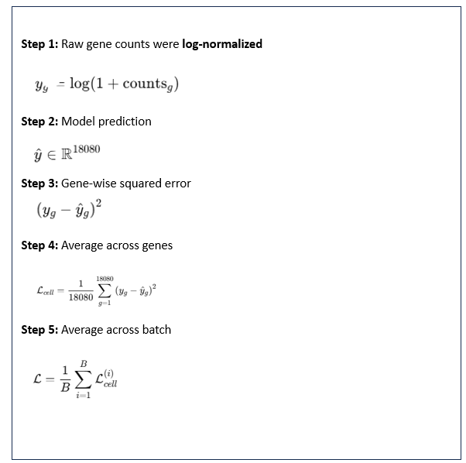
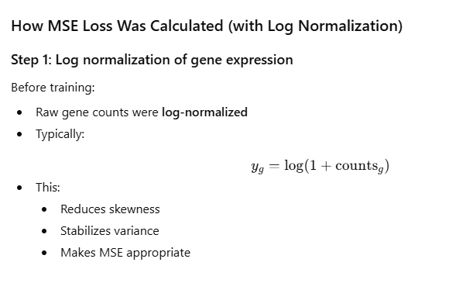
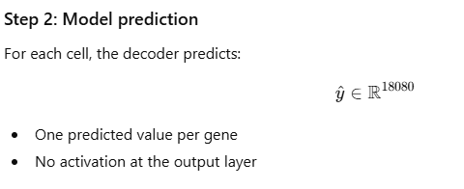
VirtualCell Generator Architecture
“We compute MSE between predicted and true log-normalized gene expression values, averaged across all genes and cells.”
“Why MSE after log normalization?”
“Log normalization stabilizes the variance of expression values, making MSE a suitable loss for continuous regression.”

Slide 10
VirtualCell Generator Architecture
Cell Vector (18,080)
Model Architecture for Transcriptome Prediction
The model takes a cell embedding of dimension 4,096 as input.
“Per-gene embeddings are projected to scalar representations to form a fixed-length cell vector, which is decoded using an MLP to predict genome-wide gene expression.”
Under input:
Missing genes use fixed padding embeddings
The input is passed through a sequence of fully connected layers, each followed by Layer Normalization and GELU activation.
Under output:
Targets are log1p-normalized expression values
The final output layer maps the learned representation to 18,080 genes, corresponding to the predicted transcriptomic profile of the perturbed cell.
Dense + LN + GELU (8192)
Dense + LN + GELU (4096)
Dense + LN + GELU (2048)
Dense + LN + GELU (4096)
Dense + LN + GELU (8192)
Cell Vector (18,080)

Slide 11
Why GELU?
Intuition
Gene embeddings and expression relationships are smooth, continuous, not binary.
ReLU makes hard cutoffs (zeroing negatives).
GELU softly gates values instead of hard-thresholding them.
Mathematically, GELU:
Weighs inputs by their probability under a Gaussian
Keeps small negative signals instead of killing them
Why GELU is good here
Embeddings are roughly zero-centered and Gaussian-like
Subtle changes in embeddings matter for expression
GELU preserves weak but biologically meaningful signals
Why Layer Normalization (LN)?
Intuition
Each cell has very different expression magnitudes
Without normalization, deeper layers:
  explode
  or collapse
LayerNorm:
Normalizes activations within each cell
Independent of batch size
Why LN is important here
scRNA-seq batch sizes can be small or variable
Expression distributions vary across cells
LN stabilizes training across layers
Why GELU + LayerNorm together?
This combo is not accidental — it’s standard in:
Transformers
Geneformer
Modern foundation models
Together they give:
Stable gradients
Smooth nonlinear modeling
Faster convergence

Slide 12
VirtualCell Generator Architecture
Cell Vector (18,080)
Slide: Model Architecture
This slide illustrates the neural network architecture used for transcriptome reconstruction and perturbation prediction.
The model takes as input a cell vector of dimension 18,080, derived from gene embeddings.
This input is passed through multiple fully connected layers, each followed by Layer Normalization and GELU activation, to ensure stable training and non-linear feature transformation.
The network progressively compresses the representation down to a 2,048-dimensional bottleneck, which captures the most informative and biologically relevant features of the cell state.
Subsequently, the representation is expanded symmetrically to recover higher-dimensional structure.
Finally, a linear output layer predicts 18,080 gene expression values, corresponding to the reconstructed or perturbed transcriptomic profile.
“GELU provides smooth non-linearity, which better preserves fine-grained information in gene embeddings compared to hard-threshold activations like ReLU.”
Dense + LN + GELU (8192)
Dense + LN + GELU (4096)
Dense + LN + GELU (2048)
Dense + LN + GELU (4096)
Dense + LN + GELU (8192)
Cell Vector (18,080)

